Slide 1

How to Really use perplexity ai

Slide 2
What is covered
What is Perplexity AI?
Getting Started
A Tour of the Environment
Quick Search (Free)
The Importance of Good Prompts
Understanding Threads
Understanding Collections
Using Focus
Working with Attachments
Pro Search (Paid)

Slide 3
What is perplexity ai?

Slide 4
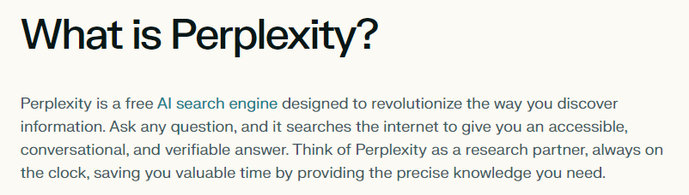
Notes:
https://www.perplexity.ai/hub/faq/what-is-perplexity

Slide 5
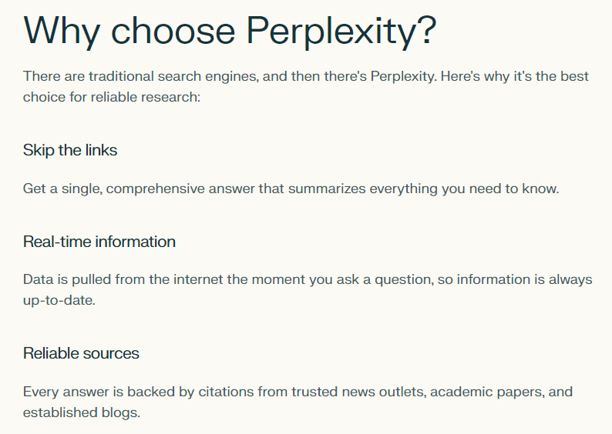
Notes:
https://www.perplexity.ai/hub/faq/what-is-perplexity

Slide 6
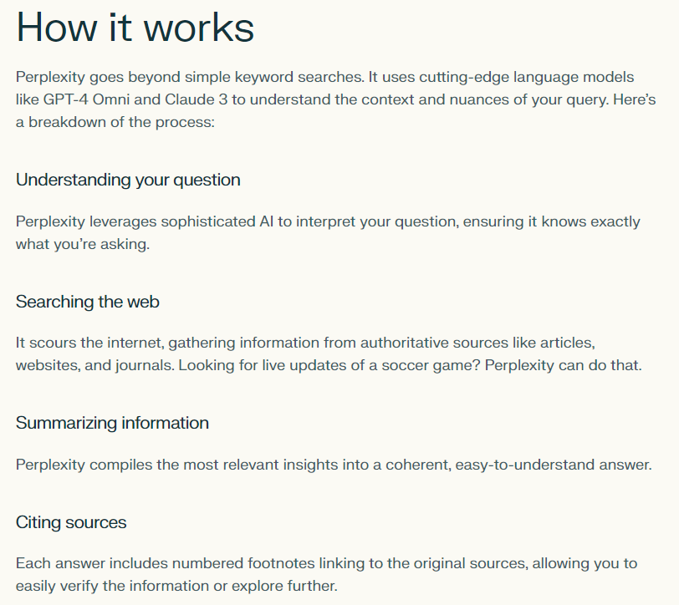
Notes:
https://www.perplexity.ai/hub/faq/how-does-perplexity-work

Slide 7
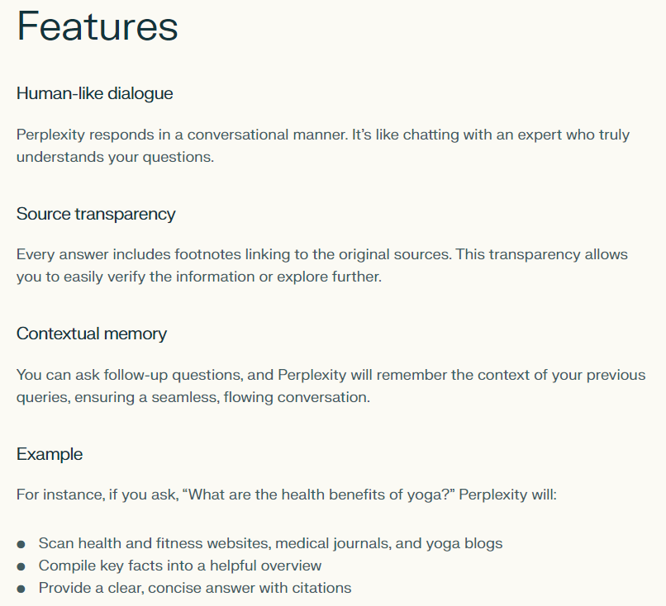
Notes:
https://www.perplexity.ai/hub/faq/how-does-perplexity-work

Slide 8
Getting Started

Slide 9
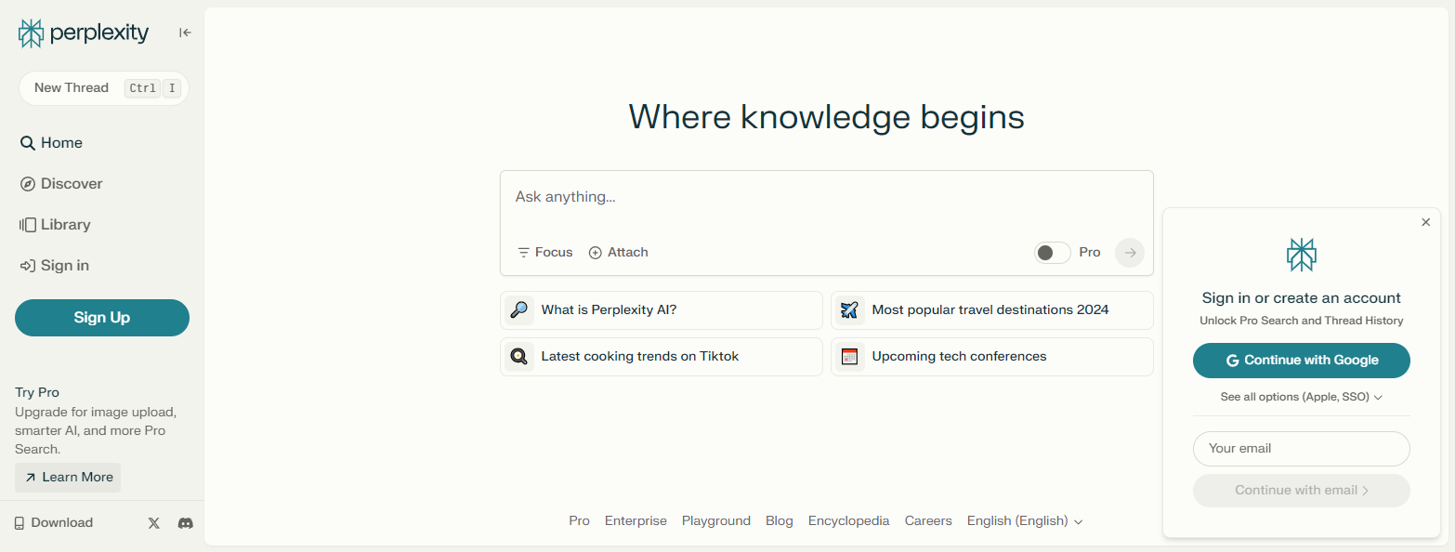
Signing In
Notes:
https://www.perplexity.ai/

Slide 10
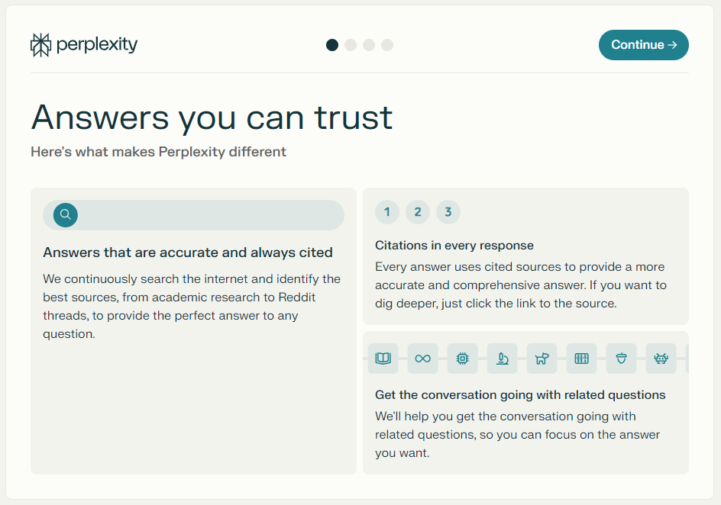
Onboarding

Slide 11




Notes:
https://www.youtube.com/channel/UC35ZpwldGw7ZJ5R-2sLijzw

Slide 12
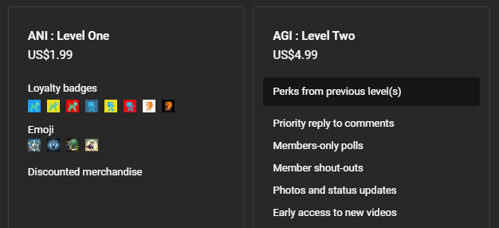

Membership has its privileges
Notes:
https://www.youtube.com/channel/UC35ZpwldGw7ZJ5R-2sLijzw/join

Slide 13

https://www.youtube.com/@AINewsFresh

Slide 14
A tour of the environment

Slide 15
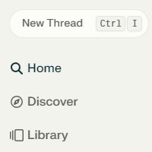
Threads

Slide 16
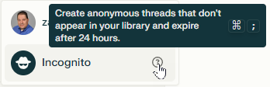
Anonymous threads

Slide 17
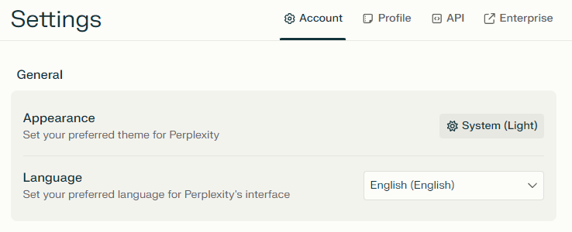
Account settings
Notes:
https://www.perplexity.ai/settings/account

Slide 18
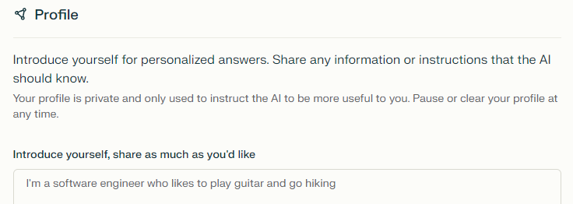
Profile settings
Notes:
https://www.perplexity.ai/settings/profile

Slide 19
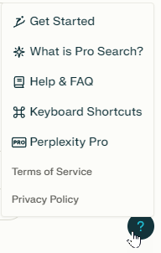
Getting help

Slide 20


